Slide 1
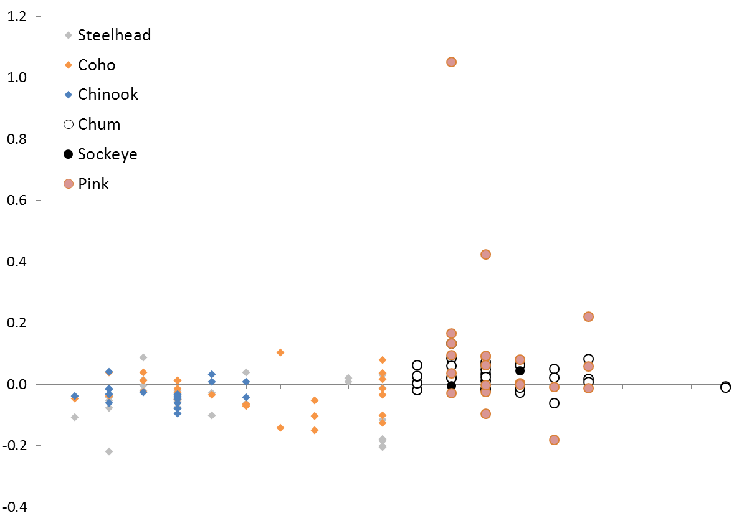
Population Trend (Holmes 2001)
SS CB HC WB SG CG NS
SS CB HC WB SG CG NS
Puget Sound JDF
Strait of
Georgia
JS PC
Puget Sound JDF
Strait of
Georgia
JS PC

